Slide 1
Bovine tuberculosis (bTB) in Michigan:
Background relevant to WGS modelling
Dan O’Brien, Melinda Cosgrove
Wildlife Disease Laboratory
Michigan Department of Natural Resources
Lili Salvador, Rowland Kao
Boyd-Orr Centre, University of Glasgow
Suelee Robbe-Austerman, Todd Stuber
National Veterinary Services Laboratory
U.S. Department of Agriculture

Slide 2
Summary, bTB infected livestock herds and wild deer, 1975-2017
69 infected cattle herds
  54 (78%) beef, 15 (22%) dairies
  8 (12%) infected twice
  68 ‘Michigan’ genotype; 1 ‘No. Amer. captive elk’ genotype
5 infected feedlots (traceouts from infected herds; don’t officially count as ‘infected herds’)
4 infected farmed deer herds (2 remain infected, under quarantine, as no $$ to indemnify)
1 infected farmed bison herd
Wild deer: 823 positive of 230,322 tested

Slide 3
bTB in Michigan, USA:
Extent of zoonotic bTB
Only two known zoonotic cases to date of bTB of MI deer/cattle strain
  Opportunistically diagnosed in aged male lung cancer patient, 2002
  Self-inoculated case in deer hunter, 2004
While other undiagnosed cases may exist, no evidence that zoonotic transmission is substantial
Wilkins et al. 2008. Emerg. Infect. Dis. 14(4):657-660.

Slide 4
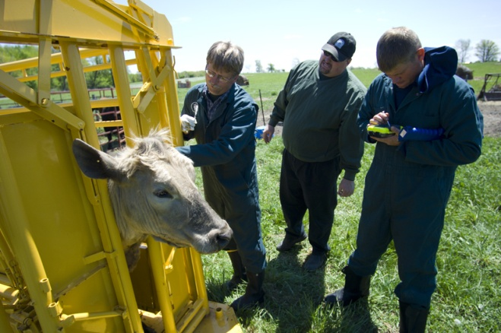
bTB in Michigan, USA:
Livestock
Elimination of bTB from cattle achievable
  Mean 3.7 breakdowns (range: 1-8, var: 2.2) per year 1998 to 2015
  1 infected animal per herd is the norm (as detected by current diagnostics)
  All MI cattle are now theoretically traceable (unique electronic identification statewide, although circumvented by producers)
Gortázar et al., 2015. Mamm. Rev. 45:160-175.

Slide 5
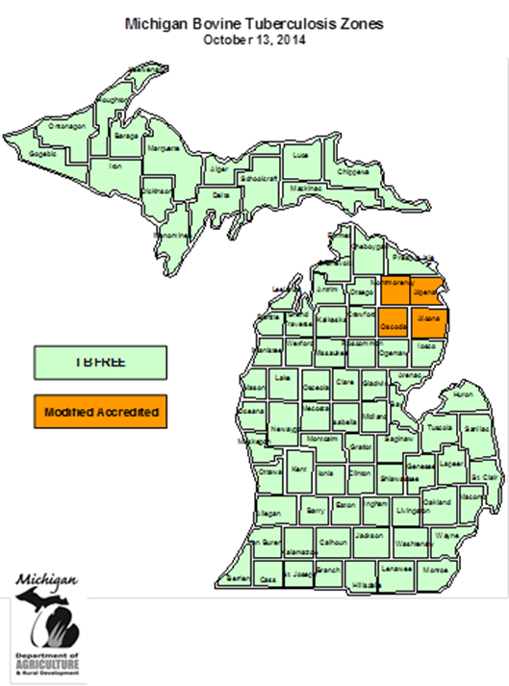
Bovine TB Accreditation Zones
  Alcona, Alpena, Montmorency
  and Oscoda counties
  340 commercial herds +
  73 freezer beef herds

Slide 6
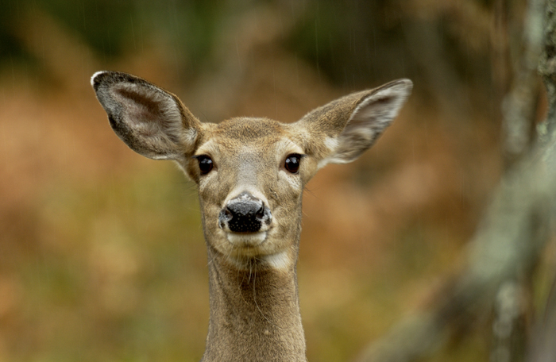
bTB in Michigan, USA:
White-tailed deer (WTD)
Justification for vaccination in MI:
Photo: D. Kenyon, MDNR
Not driven by effects of disease
  Deer are abundant across Michigan (1.7-2 million population)
  bTB-associated mortality is minimal
  Of economic & cultural, rather than conservation, significance
Principle argument is responsibility for leaving a healthy herd for sustained use of future generations

Slide 7
bTB in Michigan, USA:
WTD ecology
Not territorial
Does (females) and their female offspring exhibit remarkable fidelity to natal range
In the bTB endemic area, most does are bred as yearlings; half give birth to twins
Does typically twin annually from age 2 on
Doe groups, if infected, likely maintain bTB locally

Slide 8
bTB in Michigan, USA:
WTD ecology
Bucks (males) likely responsible for between group transmission
Transmission (largely) density-dependent
Estimated hunter harvest rates for the core bTB outbreak area:
  40% of buck population/year
  16% of the antlerless (does & fawns) population/year
  ~40% (range: 31-49%) of the annual harvest 2001-2011 composed of animals ≤ 1.5 years old
  Annual mean harvest: ~5400 from population of ~25,000-30,000

Slide 12
bTB in Michigan, USA:
Geographic scale
bTB positive deer and cattle farms by area, 1975-2014
Area | bTB+ white-tailed deer |  | bTB+ cattle farms
DMU 452 | 579/27,476 | 2.1% | 16/88 | 18%
Rest of endemic area | 143/53,010 | 0.27% | 24/585 | 4.1%
Rest of Michigan | 22/120,759 | 0.018% | 13/~12,953* | 0.1%
*USDA-NASS, 2007. Census of Agriculture, State Data, MI, 19.

Slide 13
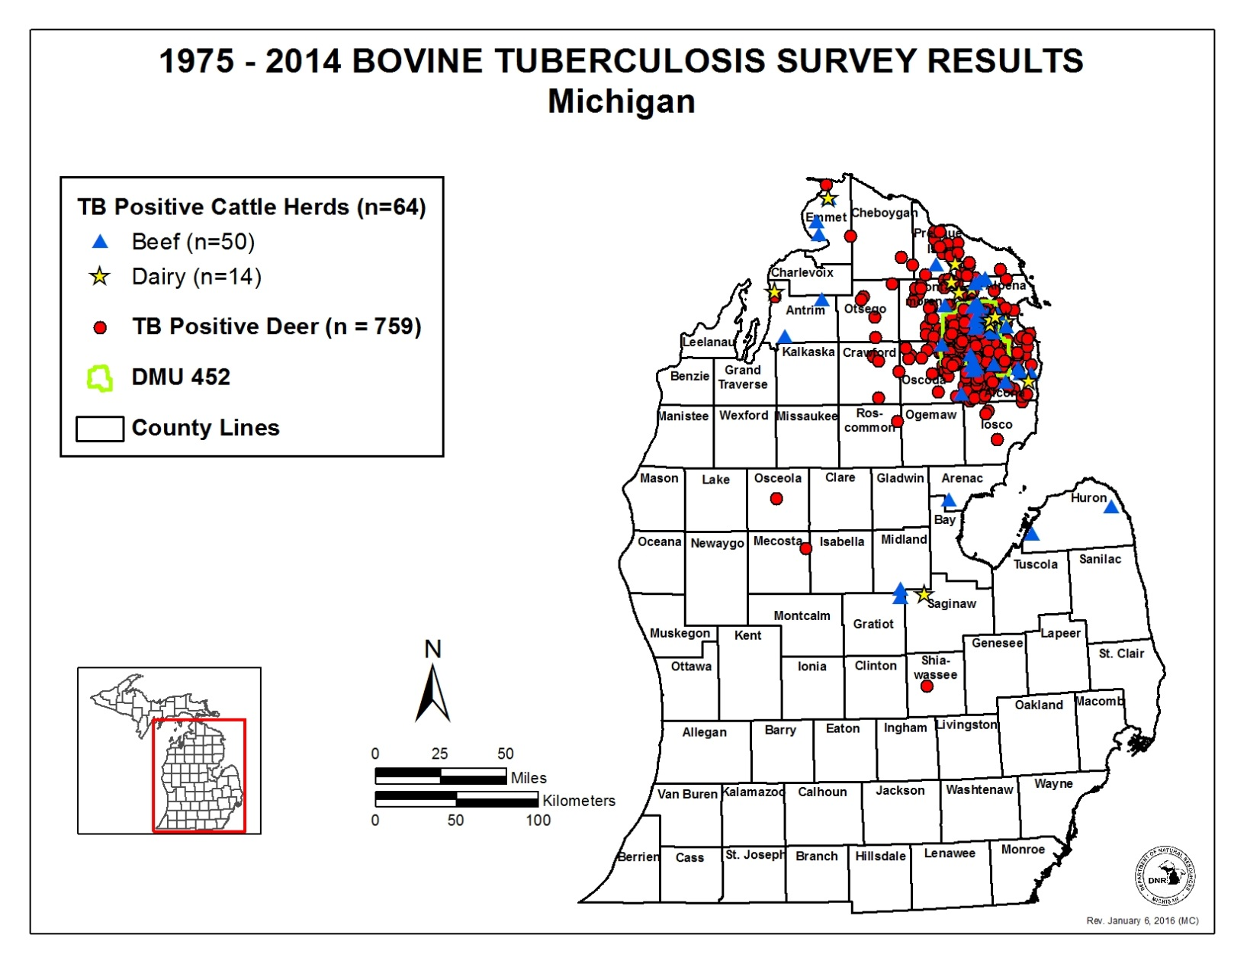
bTB in Michigan, USA:
Geographic scale

Slide 14
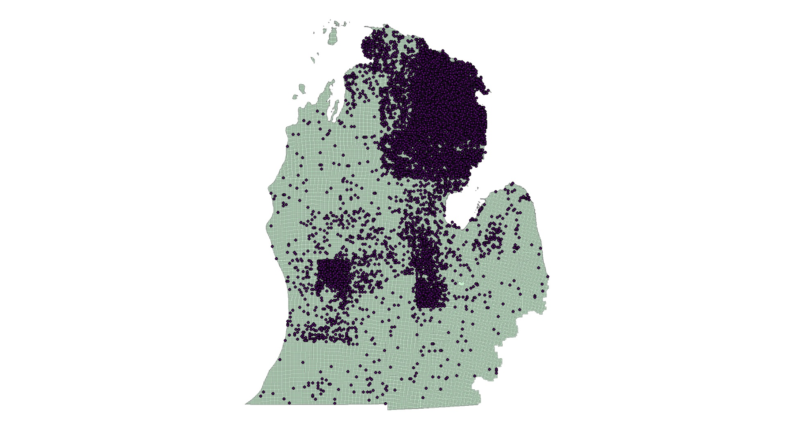
bTB in Michigan, USA:
Scale of deer testing (2009-2014)

Slide 15
Michigan M. bovis isolates to 6/2017
Species | Sequenced w/complete metadata | Pending | WGS but no/ incomplete metadata | Total
Wild deer | 613 | 0 | 47 | 660
Captive deer | 16 | 0 | 0 | 16
Cattle | 209 | Ongoing | 0 | 209+
Elk | 5 | 0 | 0 | 5
Black bear | 7 | 0 | 0 | 7
Bobcat | 3 | 0 | 0 | 3
Coyote | 18 | 0 | 0 | 18
Opossum | 2 | 0 | 0 | 2
Raccoon | 8 | 0 | 0 | 8
Red fox | 3 | 0 | 0 | 3
Total | 884 | ? | 47 | 931

Slide 16
Metadata for WGSs
All wildlife tested: Species; age; sex; method, location (to scale of 1 mi²) and date of collection; specimen(s) submitted
bTB+ wildlife: presence/location of gross lesions; histopathology; acid-fast staining; culture
Copious statewide ‘denominator’ data: >229,000 bTB-negative deer, >3,600 bTB-negative elk
bTB+ cattle (data known to be collected; may or may not be accessible): location; beef or dairy; screening (CF) and confirmatory (CCT or γ-interferon) tests; presence/location of lesions; histopathology; acid-fast staining; PCR; culture

Slide 17
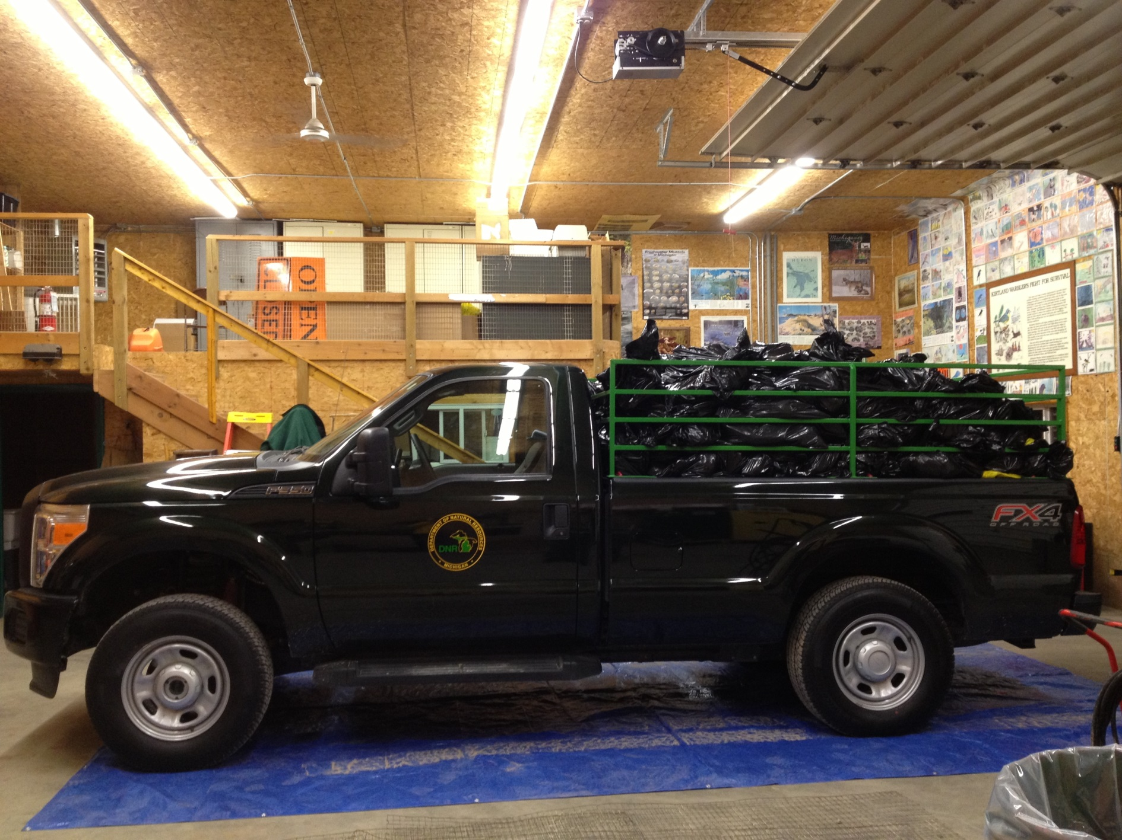


Slide 18
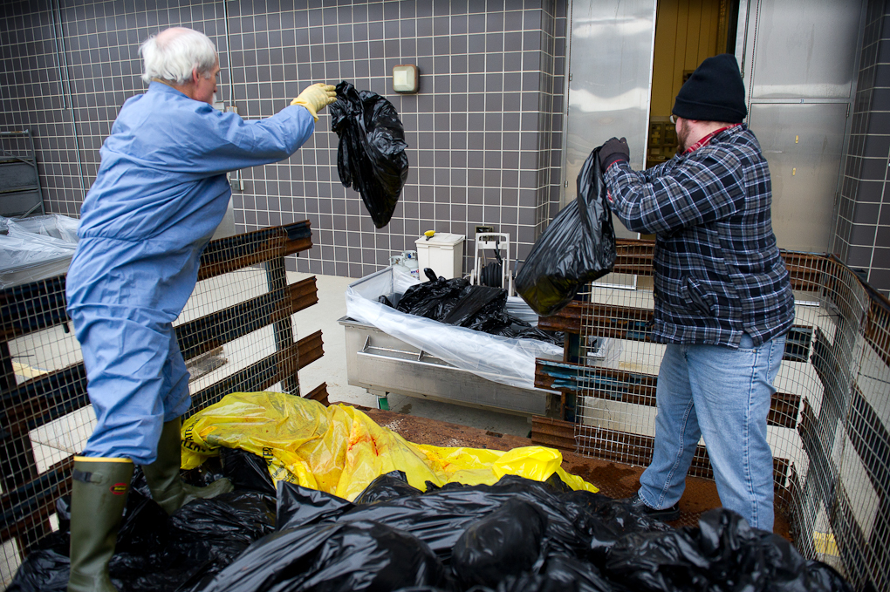

Slide 19
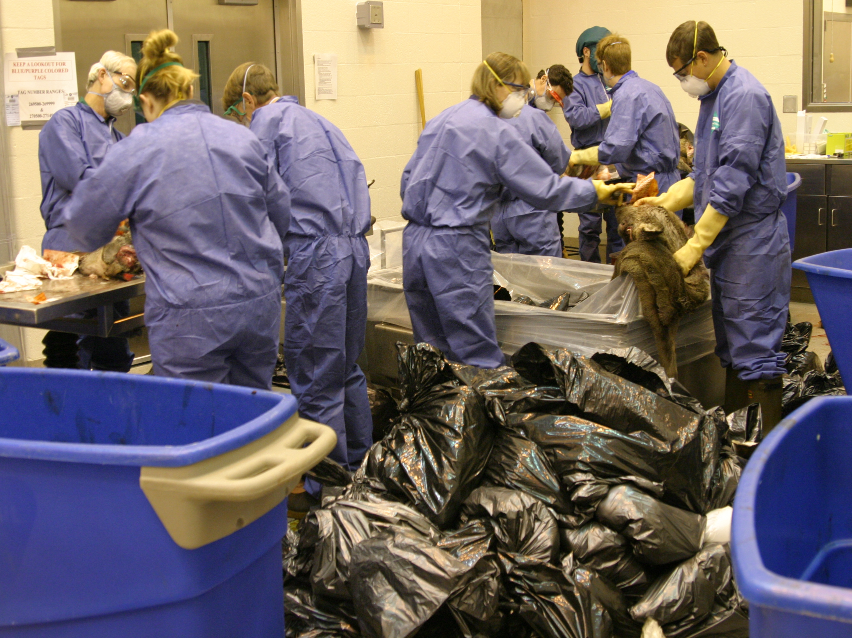

Slide 20
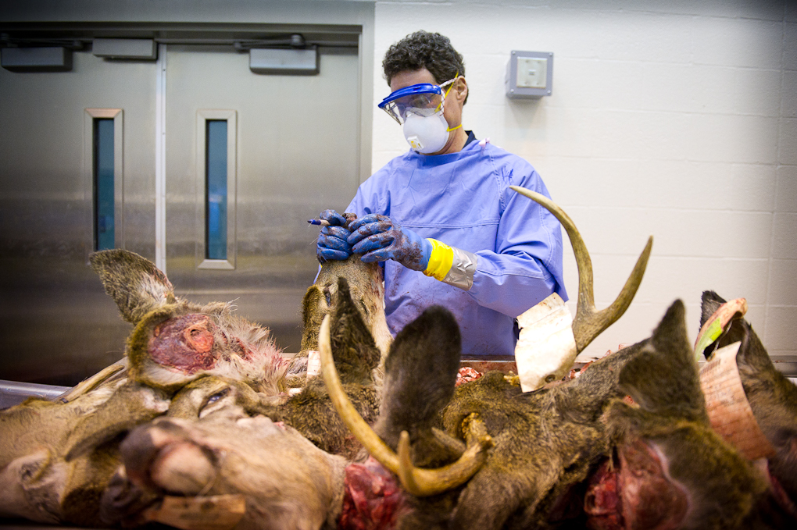
Photo: D. Kenyon, MDNR

Slide 21
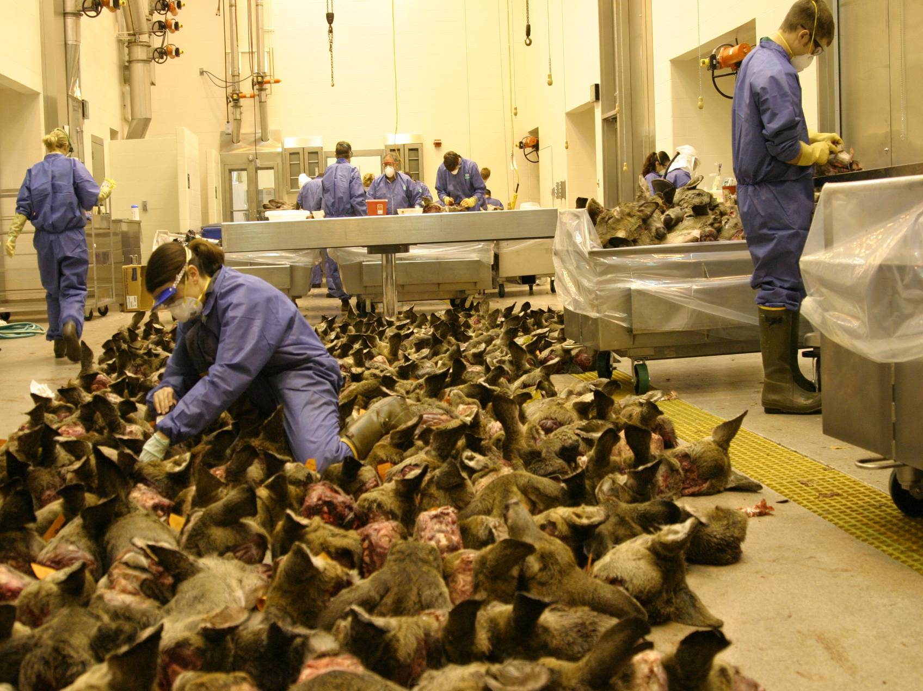

Slide 22
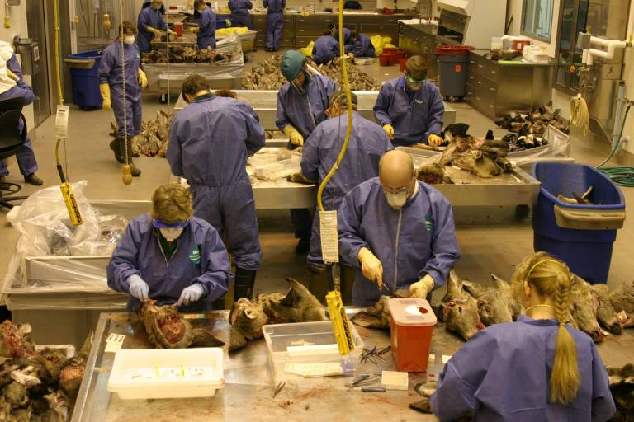

Slide 23
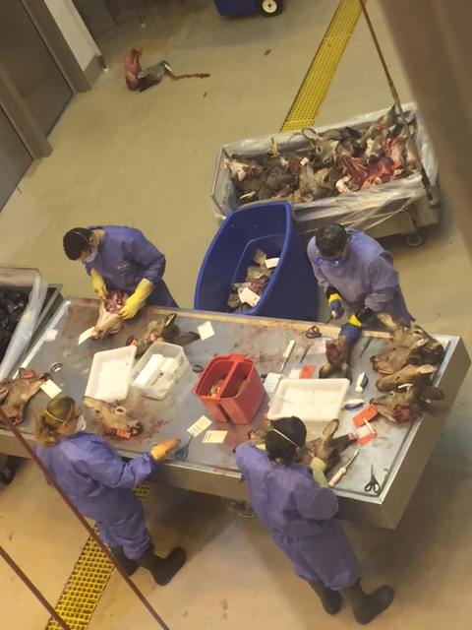
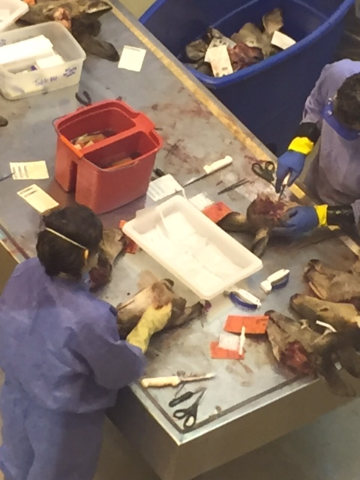
Lili

Slide 24
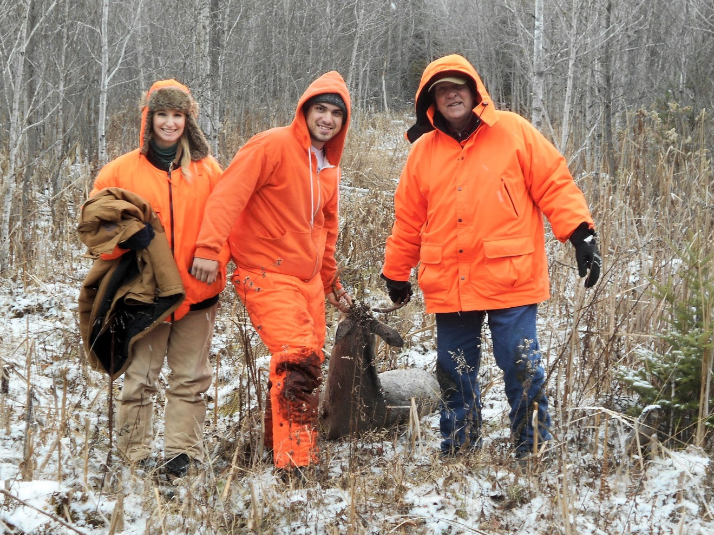
Many thanks.
Photo: E. Carlson
Dan O’Brien, Wildlife Disease Laboratory, MDNR
(517) 336-5035
obriend@michigan.gov

