Slide 1
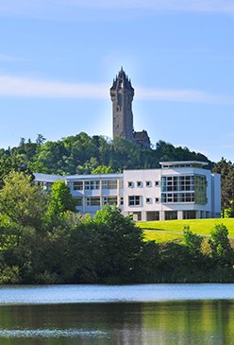
A Phylodynamic Model of Bovine Tuberculosis in Cattle and Badgers Uncovers the Role of the Unobserved Reservoir.
Anthony O'Hare, David Wright, Tom Mallon, Carl McCormick, Stanley McDowell, Hannah Trewby, Robin A. Skuce, Rowland R. Kao

Slide 2
Cattle Network
Between 2003 and 2010: 10596 isolates from cattle
193 VNTR types were identified in NI with 3 types accounting for more than 50% of sampled bacteria
Type 10 strain:
Between 1996 and 2011, 145 isolates
from 66 herd breakdowns occurring in
51 herds
The movement of cows into or out of this network extended the number of farms in our dataset by 21012 additional farms
7749685 animal movements

Slide 3
Disease Model
4 compartmental disease model
Susceptible
Exposed
Test Sensitive
Infected
Each infected animal carries a set of SNPs.
New SNPs are generated via Poisson distribution.

Slide 4
Simulation Scheme
Gillespie method
– with fixed time step
- movements at each time step
- add births/deaths at each time step
- RWHT
At the end of the simulation:
We have the full transmission tree.
Sample from this tree with the same distribution of cultured samples.

Slide 5
Inference Scheme
Likelihood function defined from pairwise SNP distance distribution

Slide 6

How Do we Solve the problem of the badgers?

Slide 7

3 Network Models
Unconnected
farms are not connected by a reservoir
Completely Connected
one single reservoir connects ALL farms in NI
Farms Within 4km are connected
Active Reservoir
create a new lineage for every incursion into herd
Passive Reservoir
no badger-badger transmission, use known lineage

Slide 8
Results

Slide 9
Results
#Infected Animals
#Herds under restriction

Slide 10
Results

Slide 11
Thank You

