Slide 1
Genetic epidemiology of bovine tb in northern Ireland
Hannah Trewby
hannah.trewby@glasgow.ac.uk

Slide 2
Overview
Relative abundances of different M. bovis VNTR-types in NI cattle
  Ecological theory combined with simulation modelling to explore possible underlying drivers
Spatial structure of M. bovis VNTR-types in NI
  Approaches to evaluate role of badgers in the spatial structure of bTB in cattle
  Use of whole genome sequencing for fine-scale epidemiology of bTB

Slide 3
RELATIVE ABUDANCES OF M. BOVIS VNTR-TYPES IN NORTHERN IRELAND

Slide 4
Relative abundances of M. bovis VNTR-types
Data on abundances of different molecular types commonly available data
  Can they tell us about the underlying dynamics of the system?
Commonly studied in ecology
  Often predicted by simple neutral ecological processes: Hubbell (2001).
Skewed distribution also seen for M. bovis in Northern Ireland
Skuce et al. 2005 Vet Rec

Slide 5
Relative abundances of M. bovis VNTR-types
All VNTR-types
Comparison of observed relative abundances and neutral theory
  Per-capita equivalence
VNTR-type distributions differ from neutral predictions
Spoligotypes fall within 95% envelope
  Lower numbers of spoligotypes => less power
  Smith et al. data also fit neutral predictions
VNTR-types by year
All spoligotypes
Trewby et al. In Review

Slide 6
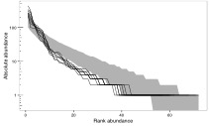
Relative abundances of M. bovis VNTR-types
Demographic simulations
  To what extent can different hypotheses replicate pattern in data?
“Superspreading” and/or historical increases could potentially generate observed pattern
Do not need systematic differences between types
  i.e. don’t need to invoke selective pressures
Increasing prevalence
Superspreading
Trewby et al. In Review

Slide 7
SPATIAL STRUCTURE OF M. BOVIS VNTR-TYPES IN NORTHERN IRELAND

Slide 8
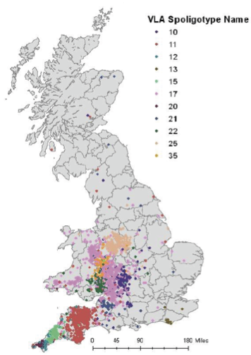
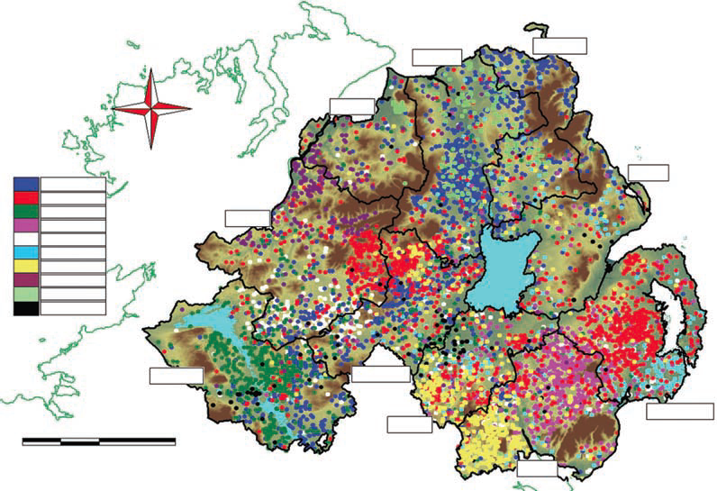
Spatial structure of M. bovis VNTR-types
Spatial clustering of M. bovis molecular types throughout Britain and Ireland
  Used for epidemiology in GB
Some regions also noted spatial correlation between molecular types found in cattle and badgers
  GB (Goodchild et al. 2012; Woodroffe et al. 2005)
  RoI (Olea-Popelka et al. 2005)
O’Connor 2012 PhD thesis
Skuce et al. 2010 Vet Rec

Slide 9
Spatial structure of M. bovis VNTR-types
We found significant correlation between:
  Abundances of VNTR-types in cattle and badgers in NI
  Spatial locations of VNTR-types in cattle and badgers in NI
Statistical model to estimate spatial occurrence of major VNTR-types in NI cattle
  Accounts for underlying density of cattle herds

Slide 10
Spatial structure of M. bovis VNTR-types
Quantify association between the spatial structure of M. bovis infections in NI cattle, and:
  Landscape features
  Badger population structure
    Allen et al. (in prep)
  Connectivity of the NI cattle population
    Recorded cattle movements between herds?
  Is spread in cattle or in badgers responsible for spatial persistence?

Slide 11
WHOLE GENOME SEQUENCING FOR FINE-SCALE EPIDEMIOLOGY

Slide 12
WGS for fine-scale epidemiology
Sequenced all isolates for one recently-emerged VNTR-type
  139 cattle isolates from 68 outbreaks
  Six badger isolates from five individual animals
  Plus samples from two ancestral VNTR-types
    Four VNTR-1 isolates: ancestral to VNTRA-10
    One VNTR-4 isolate: outgroup
  Can we use WGS to make inferences within VNTR-type?
Trewby et al. 2015 Epidemics

Slide 13
WGS for fine-scale epidemiology
Switching of VNTR-type observed in one lineage
No significant associations between genetic distance and epi. metrics
  Lack of power at the fine scale
Trewby et al. 2015 Epidemics

Slide 14
WGS for fine-scale epidemiology
  Definite advantages over molecular typing
    Resolution
    Robustness
    Potential for phylogenetic approaches
  Not without limitations
    Slow and variable evolutionary rate
    Within-host diversification

Slide 15




Thank you!
University of Glasgow
  Roman Biek
  Rowland Kao
  Jimena Guerrero Flores (University of Montpellier)
  Jason Matthiopoulos
  Dan Haydon
  Paul Johnson
  Sam Lycett (University of Edinburgh)
  Anthony O’Hare (University of Stirling)
Glasgow Polyomics
  Julie Galbraith
  Pawel Herzyk
  Graham Hamilton
AFBI Northern Ireland
  Robin Skuce
  Adrian Allen
  David Wright (QUB)
  Eleanor Presho
  Stewart McBride
  Carl McCormick
  Tom Mallon
        et al…
Department for Agriculture and Rural Affairs Northern Ireland

