Slide 1
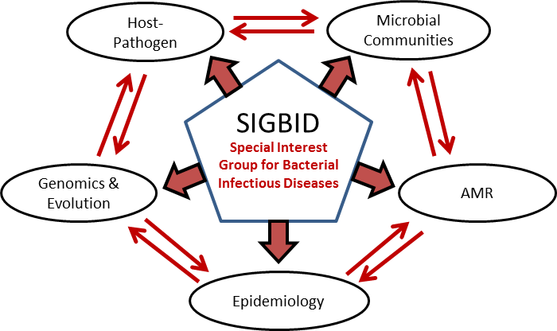
SIGBID
Special Interest Group in Bacterial Infectious Diseases
SIGBID Coordinators: Prof Ruth Zadoks and Prof José R Penadés
http://www.gla.ac.uk/researchinstitutes/bahcm/research/sigs/sigbid
Katarina.Oravcova@glasgow.ac.uk

Slide 2
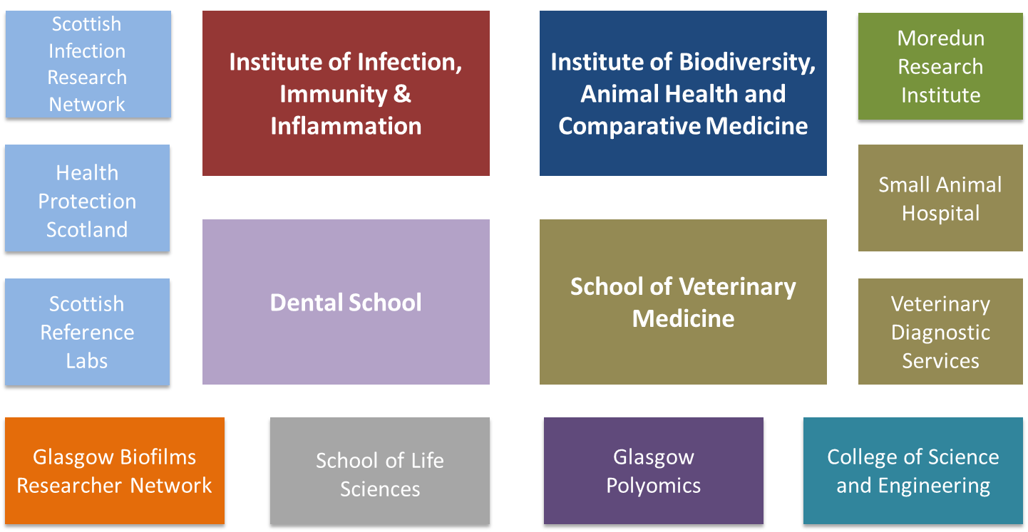
SIGBID
Special Interest Group in Bacterial Infectious Diseases

Slide 3
SIGBID
Host-pathogen interactions
Molecular basis by which bacterial pathogens interact with human and animal hosts, with the ultimate goal of identifying targets for prophylactic or therapeutic treatment
Andrew Roe, Robert Davies, Gill Douce, Tom Evans, Paul Everest
Microbial communities
Microbial biofilm communities and microbiome, their persistence, diversity and relation to antimicrobial resistance
Gordon Ramage, Karl Burgess, Konstantinos Gerasimidis, Chris Nile, Ranjith Rajendran
Antimicrobial resistance
Study of different aspects of anti-microbial resistance, from medical applications to the epidemiology of resistance
Dan Walker, Olwyn Byron, John Coia, Gill Douce, Dan Haydon, Louise Matthews
Epidemiology
Understanding the transmission dynamics of zoonoses from the point of view of molecular and comparative epidemiology, mathematical modeling and population ecology
Ruth Zadoks, Louise Matthews, Tiziana Lembo, Dan Haydon, Rowland Kao, Roman Biek, Kathryn Allan, Julio Benavides
Genomics and evolution
Understanding the emergence of epidemic bacterial clones, and the evolutionary events and successful adaptive mechanisms to new host species and/or niches
Gill Douce, Roman Biek, Rowland Kao, John Coia, Robert Davies, Katarina Oravcova

Slide 4
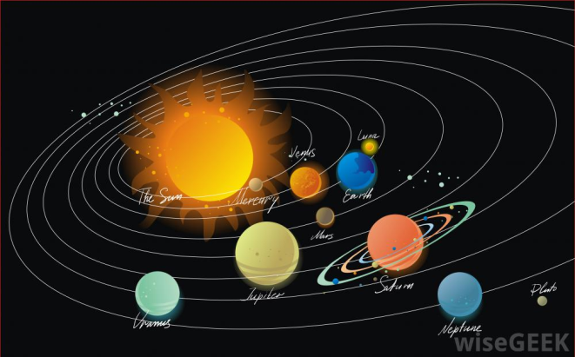
One Health Research in Bacterial Infectious Diseases
Your name here!
OHRBID
New Lab
Tiziana Lembo
Katarina Oravcova
Paul Everest
Ruth Zadoks
Mark Roberts
http://kingofwallpapers.com/orbit/orbit-001.jpg

Slide 5
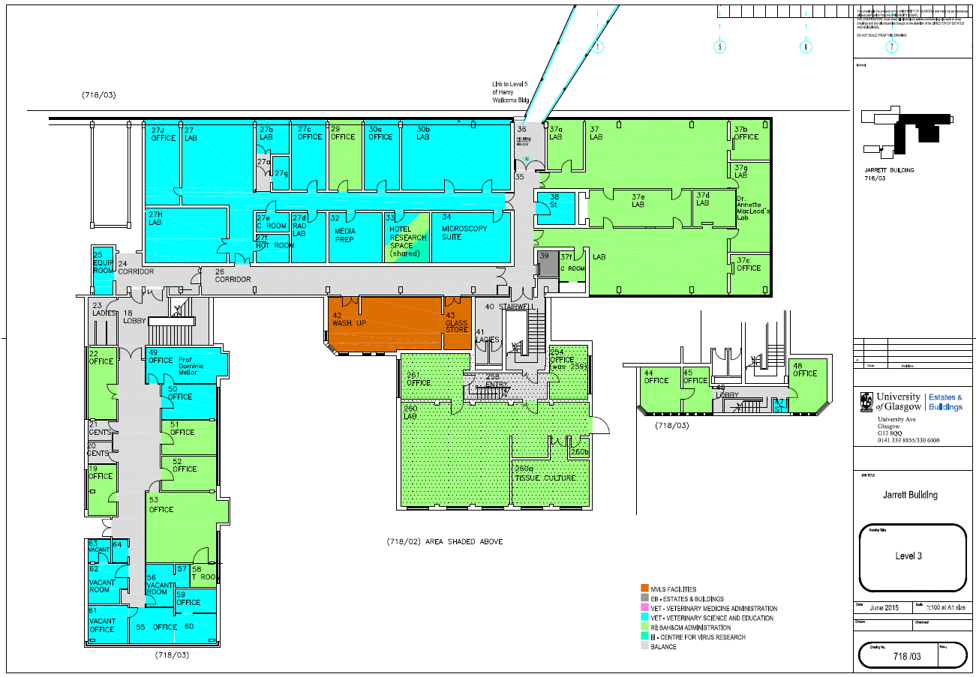


OHRBID
OHRBID
One Health Research in Bacterial Infectious Diseases
Veterinary
Diagnostic
Services
OHRBID
Epidemiology

Slide 6
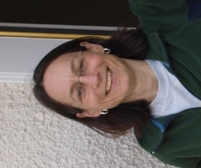
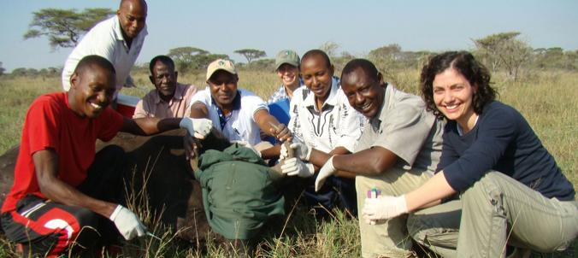
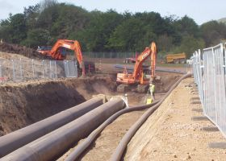
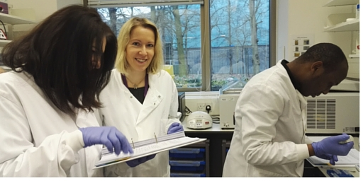
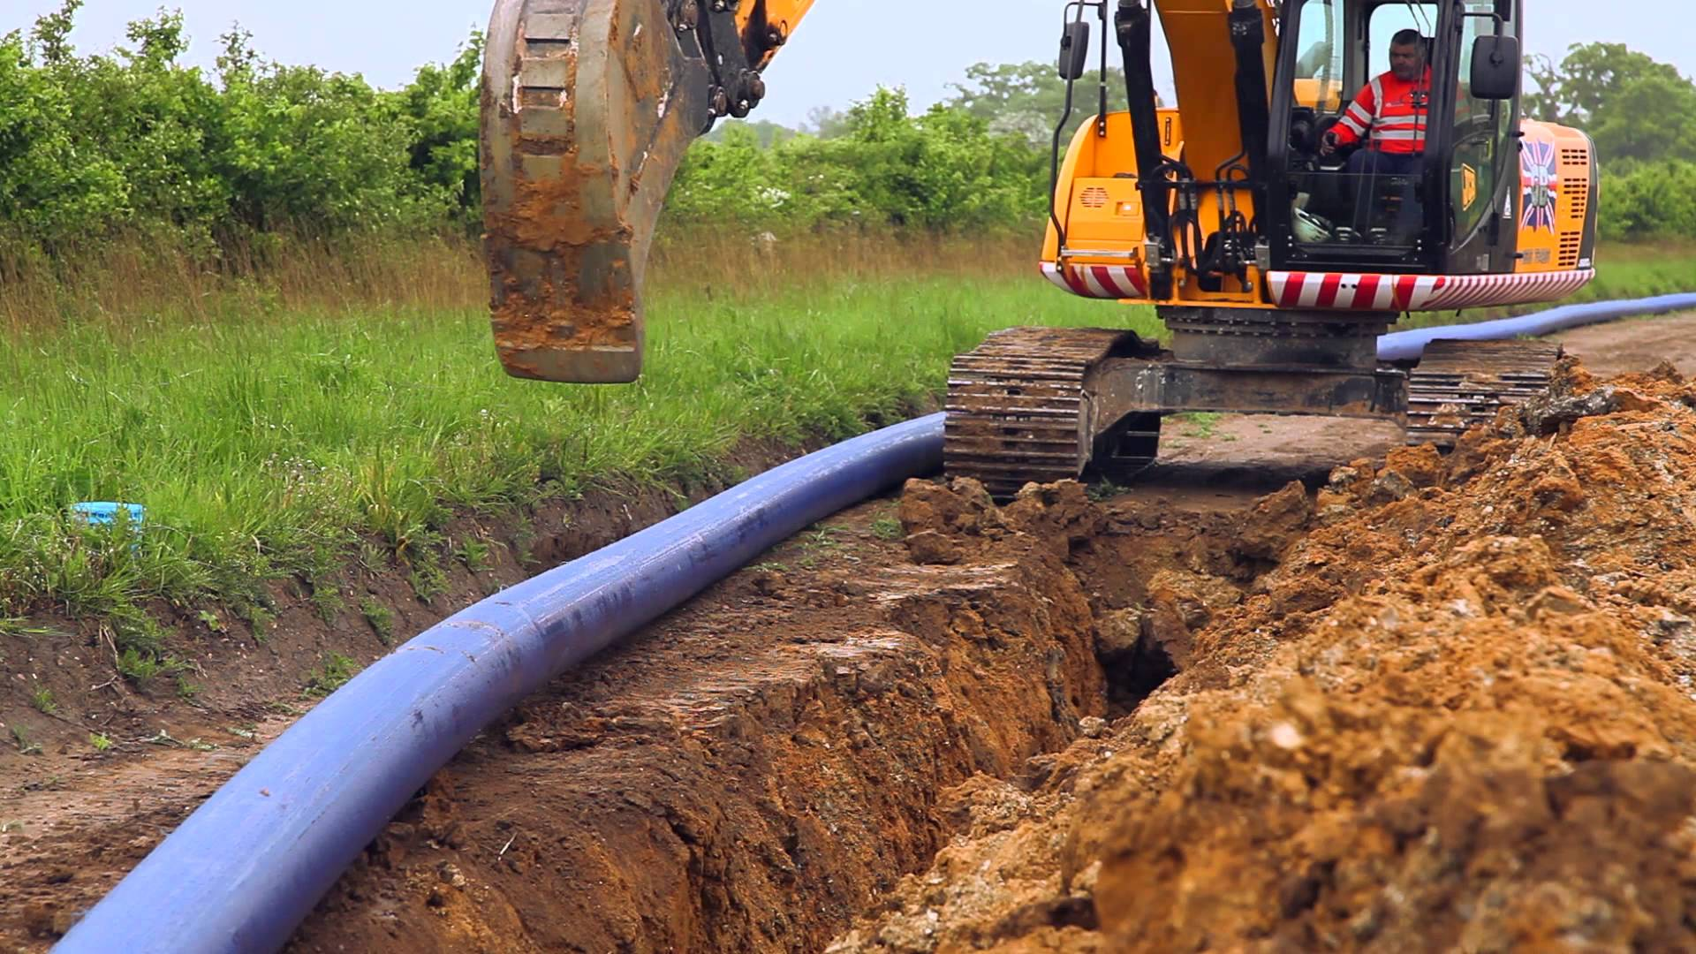
OHRBID
One Health Research into Bacterial Infectious Diseases
One Health: a collaborative and coordinated approach to combat infectious diseases
Field material collected from people, livestock and wildlife
Farmed or natural habitat in the UK and overseas
Infrastructure for diagnostic, biological and genomic data
Feed into interdisciplinary research activities
Internationally recognized research excellence with impact

